Slide 1
Module 3-HAIL website This module provides an overview of the HAIL website

Slide 2
Module 3- HAIL Website
Learning Outcomes
To be able to navigate and find resources to address mobility related disabilities and secondary conditions of pain, depression, and fatigue
To be able to navigate and find resources to empower consumers to better manage their healthcare
To be able to download information from the website if needed

Slide 3
Contents
Technology requirements needed to access the website
Demonstration on how to navigate the website
Resources available on the HAIL website
Practice with examples

Slide 4
Accessing health information
should not be like trying to sip water from a fire hose!

Slide 5
Tech Requirements to Access the Website
Internet connection;
Computer, Tablets, smartphone;
Browsers: Google Chrome, Microsoft Internet Explorer or Mozilla Firefox, etc.

Slide 6
Navigating the HAIL Searchable Website
www.hail.ku.edu
Has information from evidence-based sources
Has general information that applies to everyone, plus information that targets people with physical disabilities

Slide 7
Navigating the HAIL Searchable Website ctd.
www.hail.ku.edu

Slide 8
Navigating the HAIL website : Home - Cont’d
In the home page you will be using the following links:
About
Finding Resources
Consumer Skills
Secondary Conditions
FAQ
Suggestion Box
IL Specialist Toolkit
You may always come back to the home page at anytime to restart your search

Slide 9
Navigating the HAIL website: Finding Resources - Cont’d
This page has three sections:
Physical Disability: Click on the all the options that apply to you. Click N/A if none apply.
Secondary Health Conditions: Click on all the conditions for which you would like information. Click N/A if none of the conditions are relevant.
Health Resources: Click on all the boxes for which you would like resources. Click N/A if health resources are not applicable to you.
You will need to select at least one option from each section

Slide 10
Navigating the HAIL website: Consumer Skills -Cont’d
Fact sheets on Consumer Skills
Click on the one that best fits your needs

Slide 11
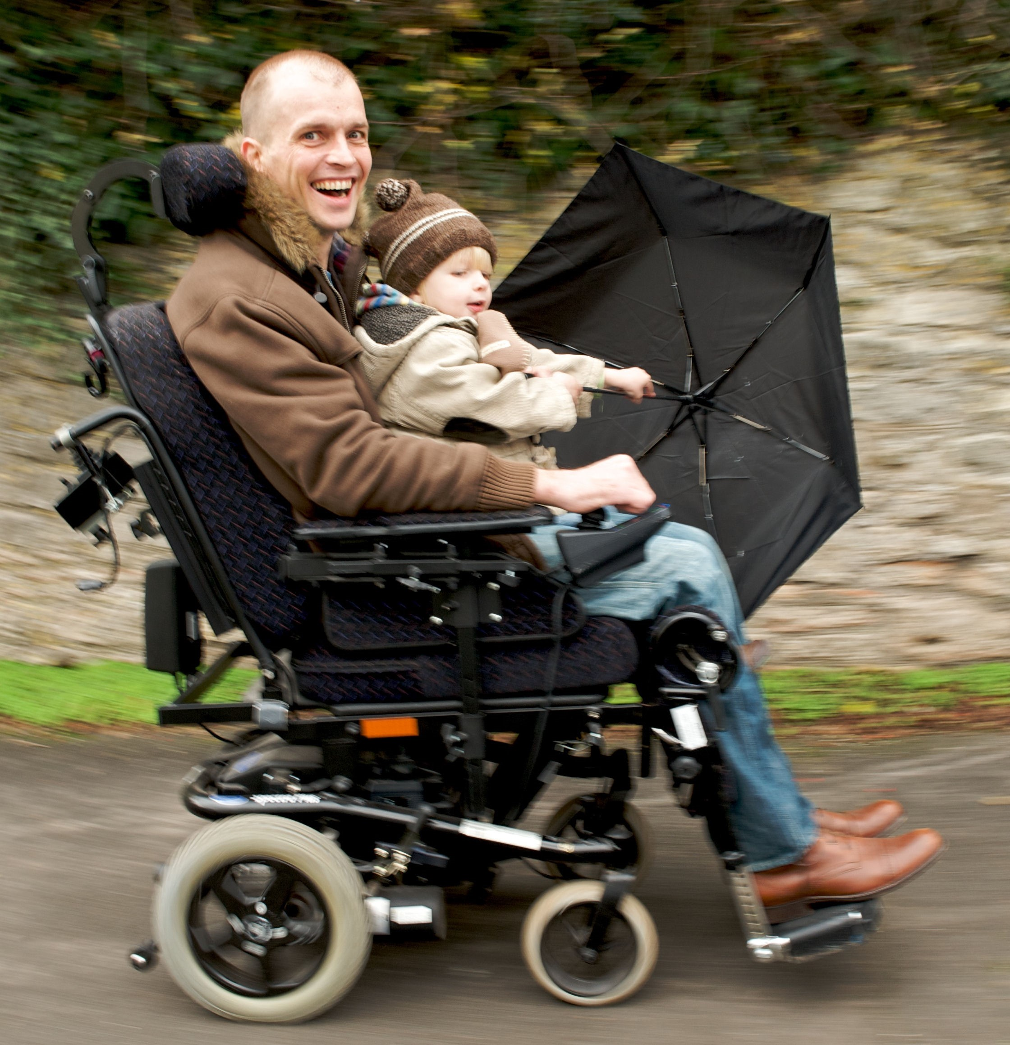
Navigating the HAIL website: Secondary Conditions - Cont’d
Fact sheets are available on three secondary conditions: pain, fatigue and depression
Click on the one that best fits your needs

Slide 12
Navigating the HAIL Website: FAQ and Suggestion Box -Cont’d
You might find answers to some of your questions
If not, please use the Suggestion Box to email your questions and comments to us. We will get back to you as soon as possible.

Slide 13
Navigating the HAIL website: IL Specialist toolkit- Cont’d
Training materials we used to teach Independent Living Specialists and people with disabilities on how to use the HAIL program
Resources such as checklists, worksheets, and forms to help with setting and achieving short term health goals

Slide 14
Practice Let’s try some examples

Slide 15
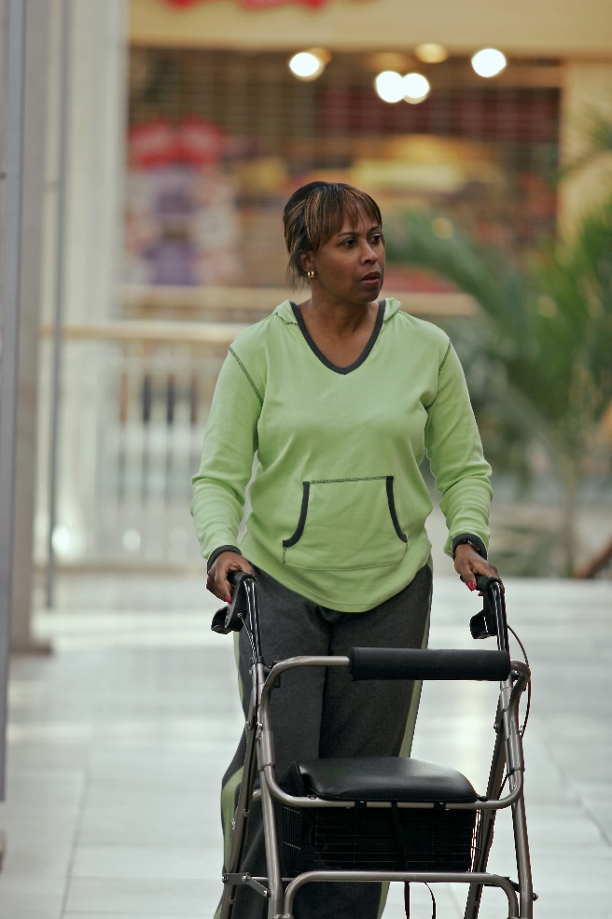
Example
Shawntell is 50 years old with Parkinson’s disease;
She has problems with walking;
She feels sad and frustrated about her illness;
She visits her local CIL.
Notes:
Aruna
Shawntell has been having a lot more tremors lately that inhibit her from walking around to do his daily chores. The doctor has suggested that she look into using a walker. She would like a walker but is unsure of what type she needs.
Shawntell often feels sad and unable to cope with her struggle with Parkinson’s. She is taking medications to control her tremors but wonders what else she can do to lift her spirits. She would like to try some non medical ways to address her sadness.
Shawntell visits the ILC to learn about walkers and find out more information on how to combat her mood swings.
As part of step 2 After speaking with Sheila, the IL specialist downloads fact sheets on Assistive Technology and Depression and Parkinson’s disease from the HAIL website. Sheila and the IL specialist decide to meet in one week to set goals after she has had a chance to look over the handouts.

Slide 16
Example-Contd.
After talking with her ILS , Shawntell decides to explore the following topics on the website:
Consumer Skills: Shawntell decides she would like more information on Assistive Technology and walkers
Finding Resources: Shawntell decides to address her sadness by searching for information on depression

Slide 17
Example-Ctd.
Based on the resources she finds on the HAIL website, Shawntell goes back to her ILS to set goals to address her depression and problems with walking.
Notes:
Aruna
Shawntell has been having a lot more tremors lately that inhibit her from walking around to do his daily chores. The doctor has suggested that she look into using a walker. She would like a walker but is unsure of what type she needs.
Shawntell often feels sad and unable to cope with her struggle with Parkinson’s. She is taking medications to control her tremors but wonders what else she can do to lift her spirits. She would like to try some non medical ways to address her sadness.
Shawntell visits the ILC to learn about walkers and find out more information on how to combat her mood swings.
As part of step 2 After speaking with Sheila, the IL specialist downloads fact sheets on Assistive Technology and Depression and Parkinson’s disease from the HAIL website. Sheila and the IL specialist decide to meet in one week to set goals after she has had a chance to look over the handouts.

Slide 18
Any Questions?

